Slide 1
Prince of Peace Catholic Montessori
School Wide
Safe In School
Behavior Plan
(COVID-19)
2020-2021 school year
On-Going
Work
In
Progress

Slide 2
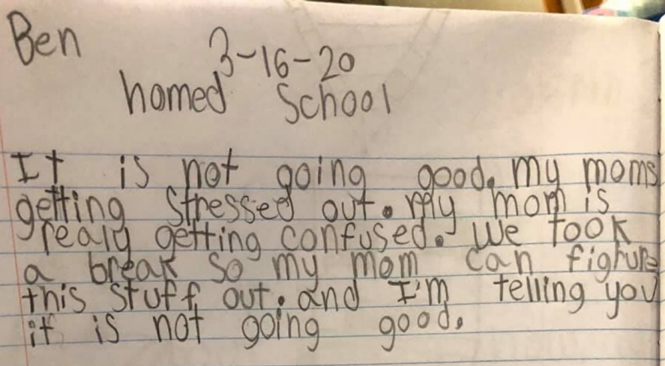
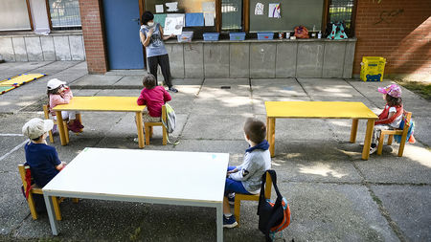
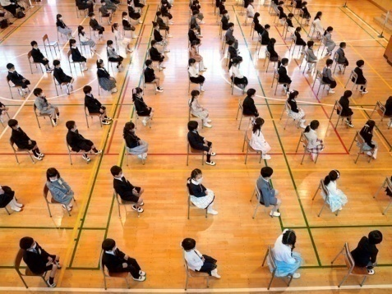
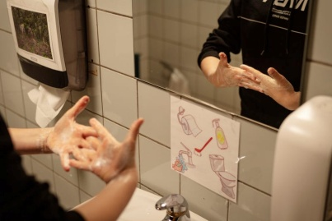
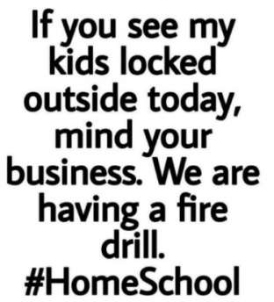
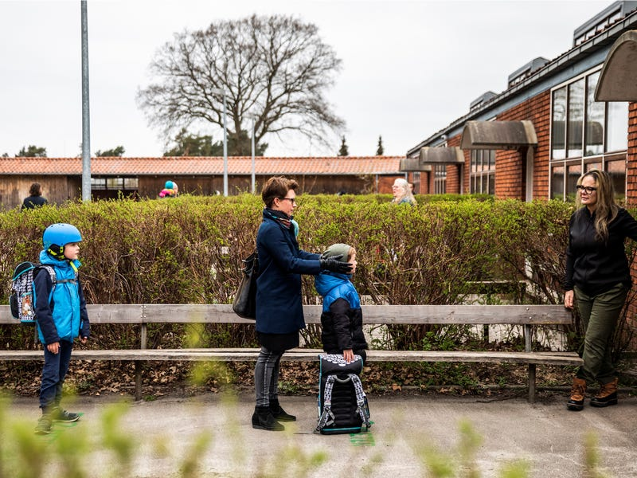

Slide 3
Dr. Stephen Stack (Team Kentucky) has created a mantra to help Kentuckians to be safe. His mantra is HANDS....FACE....SPACE...TESTING. Governor Beshear uses this 3-word mantra during his Press Conferences HANDS...FACE...SPACE. Piggy-Backing on this idea…
POP COVID-19 Task Force has created a school wide mantra:
HANDS....FACE.....SPACE.....SAFE.
HANDS = Washing hands correctly
FACE = Mostly wearing the mask, but could include don’t touch your face, eyes, mouth, etc.
SPACE = Social Distancing of 6 feet and how to work together safely.
SAFE = Safe from germs, getting sick etc.
(Explanation depends on developmental level, COVID-19)
American Sign Language gestures = Hand gestures to act out the mantra to review safe behaviors throughout the school year. Kids retain info better when it's connected to movement. The brain stores it in more than one place when it's connected to movement.
The staff develops a purposeful unified program or a set of concepts to teach the behaviors that we expect. We present a unified program for students, staff and families. The students hear the same language\concepts referring to the expected behavior from all members of our community.

Slide 4
This is a handout has some tips for parents on talking to kids of different ages:
https://chfs.ky.gov/agencies/dph/covid19/copingkidsandfamilyedition.pdf
Some useful information from this handout:
Don’t be afraid to talk about it.
Invite them to tell you what they know and how they feel about it, but don’t force them to talk.
Show that you hear and understand their thoughts, feelings, and reactions. Be reassuring.
Focus on what we’re doing as a school to stay safe.
Give easy to understand explanations for your student’s age and developmental level.
Toddler/preschool: Emphasize washing hands for 20 seconds. Practice a simple song with them so they can understand how long that is. Explain that adults are working hard to keep everyone healthy and safe.
Elementary age: Give simple explanations. Be honest and stick to the facts. Discuss ways to help others during this time.
Middle school: Answer questions and let them discuss feelings of anxiety or worry. Help them understand how to get reliable information from the media. Encourage acceptance of all people that are hurting right now and try not to blame certain people or populations for what is happening. Discuss ways to help others during this time.
High school: Discuss questions about health, the economy, and the impact on your community, the state, the country, and the world. Let them talk about their
worry, anxiety or fear and remind them these are normal reactions. Stick to the facts and point them towards reliable sources of information. Discuss the difference between being informed and media over-use that can create too much anxiety. Discuss ways to help others during this time.
Educational Resources page since school closed and there are a few other articles we might use to create school wide safe behaviors program. This is the link to POP Educational Resources Page: https://www.popcov.com/educational-activities/

Slide 5
Implementing School Wide Plan
The steps we take to carry out our school-wide Safe at School plan include the following:
Define Common Behavioral Expectations: in common areas for students, staff, community members (including parents), and principal.
Provide Positive Reinforcement: positively reinforce desired student behaviors
Use Interventions to Redirect Behavior (i.e. teach the skill\s again, do not punish errors)
All staff commit to teach, model, cue (remind students regularly), and reinforce positive safe behavior:
We recognize that all students need structure and clearly stated high expectations in order to learn and succeed.
Research states that repetition is key to learning skills. According to Harry Wong: “For a child to learn something new, it needs to be repeated 8 times”
For a child to unlearn an old behavior and replace with a new behavior, it needs to be repeated 28 times. If students are not showing the expected behavior, teach the expectation again. In other words, don’t focus on the incorrect behavior.
We define behavioral expectations and provide “the why” behind our expectations and when to use the skills. Review skills in context (“The Teachable Moment”)
We recognize that students need to know that all of us have unified expectations in our POP community.
This handout will be posted on POP website.
Click>> COVID-19 Updates, then>>>Classroom COVID-19 Updates, then>>> Hands Face Space Safe

Slide 6
HANDS....FACE.....SPACE.....SAFE
MONTRA
HANDS =
Gesture washing hands
FACE = Trace a circle counterclockwise around your face
Then>>
SAFE =
SPACE = Hand, palm down
Make counterclockwise circle
Right fist on top of left fist
Pull fists apart

Slide 7
HANDS....FACE.....SPACE.....SAFE
Common Expectations
SCHOOL WIDE:
#
1
All students, staff, volunteers will say and sign the school wide mantra
HANDS, FACE, SPACE, SAFE
HANDS:
All students can demonstrate how to wash hands effectively with soap\water & hand sanitizer. (all parts of the hands and how long it should last)
All students know when they are expected to wash hands with soap\water & hand sanitizer.
FACE:
All students know how to cough and sneeze to prevent passage of germs to others (Vampire Cough & Sneeze)
When developmentally appropriate, students should know when to wear a mask.
When developmentally appropriate, students should know how to wear a mask.
When developmentally appropriate , students can explain why we wear a mask and touching eyes, nose, and mouth can spread germs.
SPACE:
All students know how far is 6 feet.
(i.e., social distancing considering developmentally appropriate)
2. All students will be able to demonstrate safe ways to work with others.
SAFE:
1. All students can explain how HANDS, FACE, SPACE can keep everyone SAFE.

Slide 8
HANDS
The videos on the next page give this information. These practices are based on the current knowledge\research and may change as we learn more.
How long should we wash hands with soap and water?
Pre-K = duration of a song
Handwashing for preschoolers https://www.canr.msu.edu/news/handwashing_for_preschoolers
Wet your hands with very warm, running water.
Apply liquid soap.
Scrub hands for 10 to 15 seconds, remembering to wash both front and back of hands, as well as in between fingers.
Rinse thoroughly with running water.
Dry hands with a single use paper towel or air dryer.
1st grade to adults = At least 20 seconds (Same steps for Hand Sanitizer, just no rinse)
Wet hands
Apply soap
Scrub Palm to Palm
Backs of the hands
Thumbs
Between fingers
Knuckles to palms
Fingertips\Under your nails
Rinse. Scrub at least 15 seconds before rinsing
Dry + use the paper towel to turn off the faucet and open the door
When to wash hands:
Before and after Lunch
After recess
Establish a routine in your classroom

Slide 9
How to wash your hands. Choose videos that are appropriate for your students:
https://www.youtube.com/watch?v=8QnunFtuth8
YouTube Video for washing hands for Ages 2-6 1 min. 20 sec.
https://www.youtube.com/watch?v=LQ24EfM7sEw
Importance of washing hands. Goes through steps of properly washing your hands Ages 7 and up 5 min. 5 sec.
https://www.youtube.com/watch?v=ggHtoeQrGxQ
Dr. Oz shows Jimmy Fallon how to wash hands and answers a few questions about COVID-19, Social distancing, Also says eat right, get sleep, Junior High 4 min. 40 sec.
https://www.youtube.com/watch?v=seA1wbXUQTs
Short and to the point\How to wash your hands Any age 36 sec.
“Wash your hands” Songs:
https://www.youtube.com/watch?v=L89nN03pBzI
Wash your hands (to the tune of Baby Shark) 1 min. 46 sec.
Maybe change to a chant.
No singing.
Singing can spread the virus.
https://www.youtube.com/watch?v=dDHJW4r3elE
Wash your hands song 3 min. 20 sec.
https://www.youtube.com/watch?v=Vr6GQN-z_2s
Superstar Hand washer Ages 7 and up 3min. 8 sec.

Slide 10
A poster
with steps
for
washing hands
Click this link to print poster:
https://www.cbc.ca/parents/content/pdf/KIDS_Handwash_Steps_Print.pdf

Slide 11
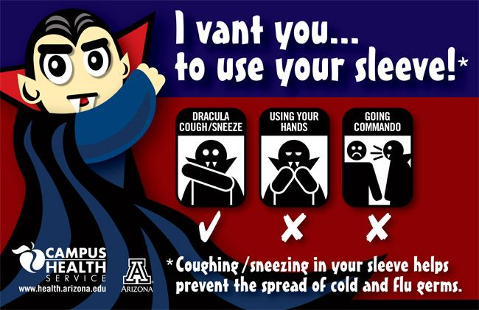
FACE
Face:
#
1
All students know how to cough and sneeze to prevent passage of germs to others (Vampire Cough & Sneeze)
Vampire cough and sneeze videos
https://www.youtube.com/watch?v=S4vObywdvYw
7 year old girl demonstrates vampire sneeze Preschool age –and up
https://www.youtube.com/watch?v=cQOSh6GLa_w
People demonstrate how far a sneeze can travel Ages 6 and up
https://www.youtube.com/watch?v=XZJ90r7pi3Q
Book\Poem about the Vampire Cough Ages 6 and up
https://www.youtube.com/watch?v=3vw0hIs2LEg
Mythbusters…How far a sneeze can travel
Ages 9 and up
Poster
Available online

Slide 12
FACE
https://www.youtube.com/watch?v=4KRuP1QGmhU&feature=youtu.be - Wearing a mask video made by Cincinnati Children’s Hospital
Masks:
-Based on COVID-19 Prince of Peace Catholic Motessori School Policy
Always wear a mask in the hallways (Going to and from specials, lunch, recess, etc.)
(See School Policy—Diocese current plan = masks for 1st grade and up)
2. When not wearing a mask, students should fasten it to their lanyard.
When developmentally appropriate, students should know when to wear a mask.
When developmentally appropriate, students should know how to wear a mask.
When developmentally appropriate, students can explain why we wear a mask and touching eyes, nose, and mouth can spread germs.
Excellent video showing how germs can spread in a 3rd grade classroom:
https://www.youtube.com/watch?v=I5-dI74zxPg 3rd grade and up 10 min. 20 sec.
Could be a great science experiment in your classroom.
My Mask Protects You…..Your Mask Protects Me. (Love one another as I have loved you)
Maybe put a heart on their masks. (just a suggestion)

Slide 13
This poster
is available online from the
CDC
Very Important
For
Older students

Slide 14
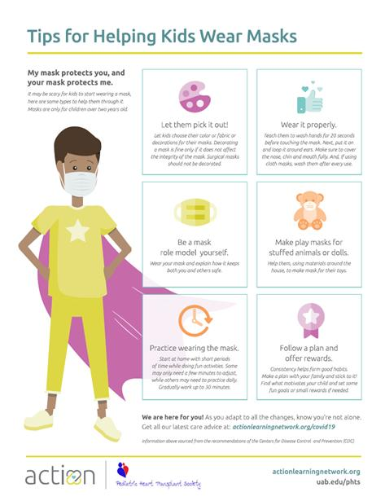
This poster
is available online
Click this link to find a printable poster:
https://med.umich.edu/mott/thrive/tips-for-helping-kids-wear-masks

Slide 15
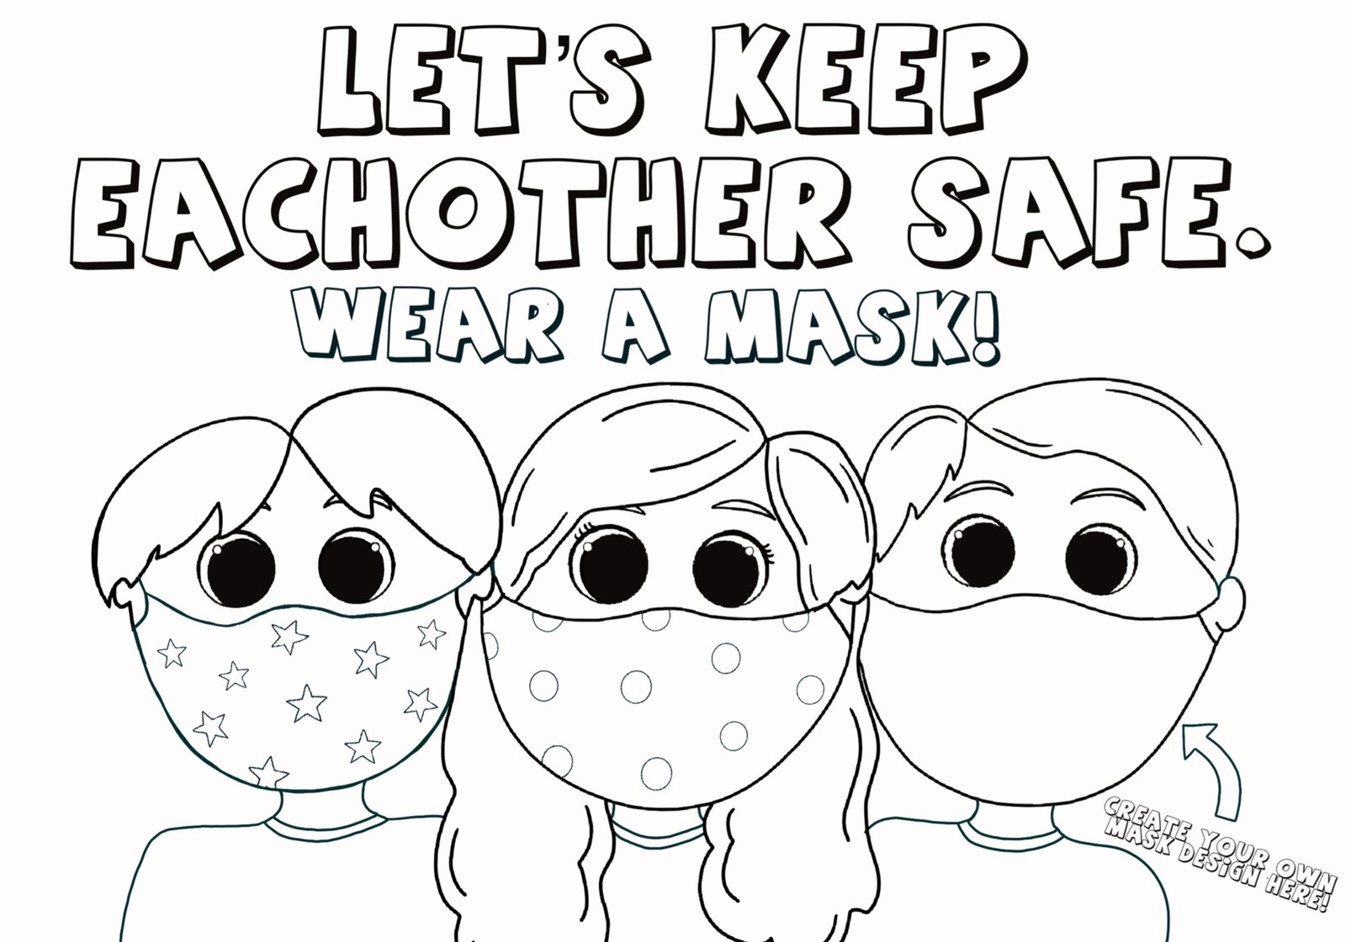
Wear a mask coloring page

Slide 16
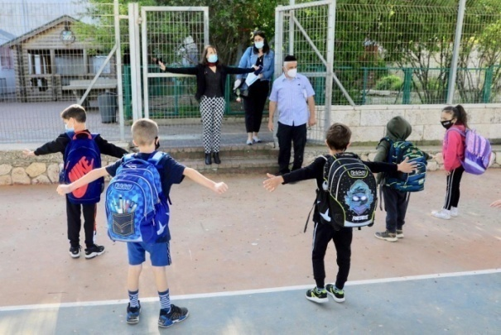
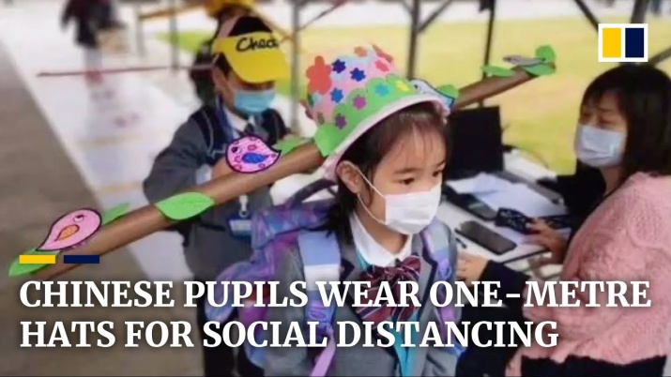
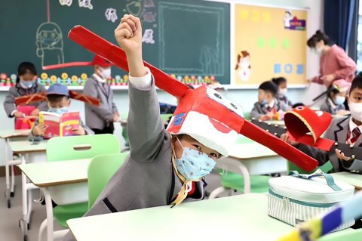
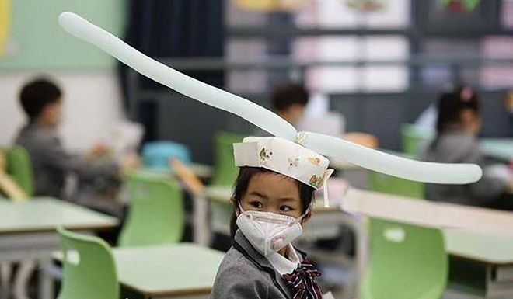
SPACE
All students know how far is 6 feet.
(i.e., social distancing where developmentally appropriate)
A printable picture showing social distancing. Click this link:
https://www.popcov.com/wp-content/uploads/2020/08/Social-distancing-picture.jpg
3. All students will be able to demonstrate safe ways to work with others.
(i.e., sitting next to is better than across from each other, wash hands after working together,

Slide 17
SAFE
All students can explain how HANDS, FACE, SPACE can keep everyone SAFE. (the “WHY”)
You know your students. Students explanations will vary according to their developmental stage.
Here are some websites that might assist you:
https://kidshealth.org/en/parents/coronavirus-how-talk-child.html (Updated July 2020)
https://iocdf.org/covid19/talking-to-kids-about-covid-19/
https://childmind.org/article/talking-to-kids-about-the-coronavirus/
https://www.aacap.org/App_Themes/AACAP/Docs/latest_news/2020/Coronavirus_COVID19__Children.pdf
https://www.mayoclinic.org/diseases-conditions/coronavirus/in-depth/kids-covid-19/art-20482508

Slide 18
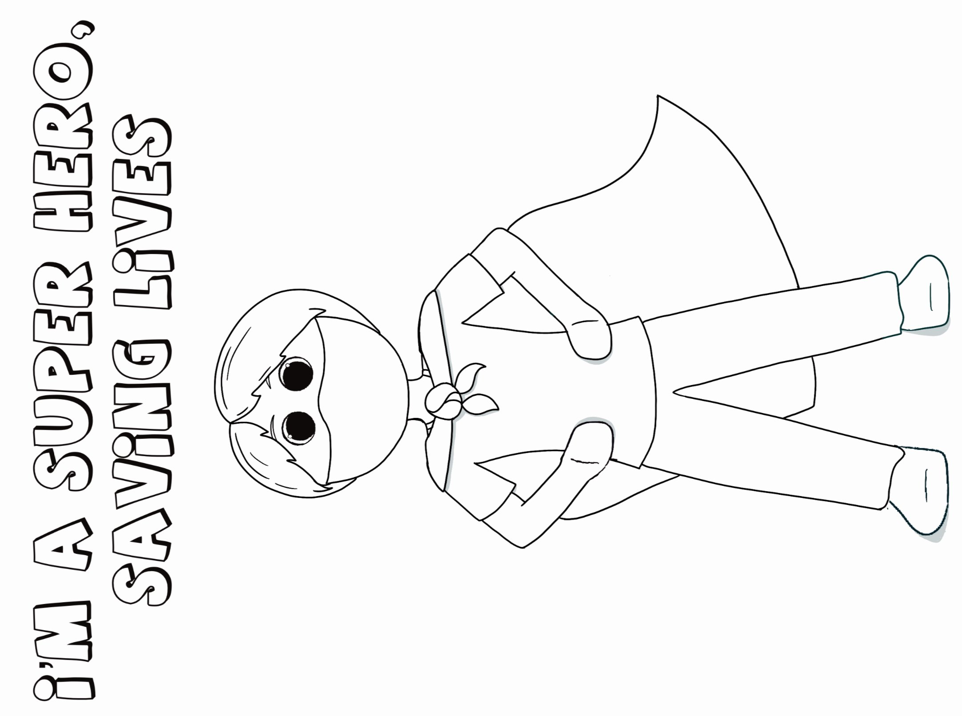

Slide 19
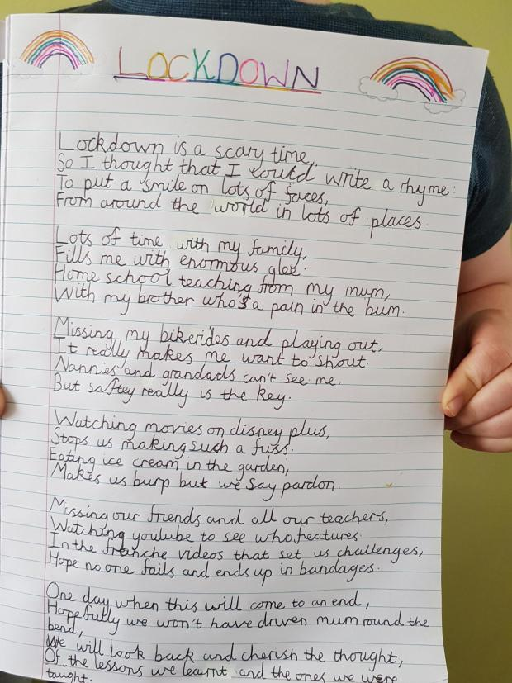
Consider writing assignments:
-Write or Draw describing our Safe At School Mantra
-Write or Draw feelings about COVID-19
-Write or Draw about experiencing stay-at-home

Slide 20
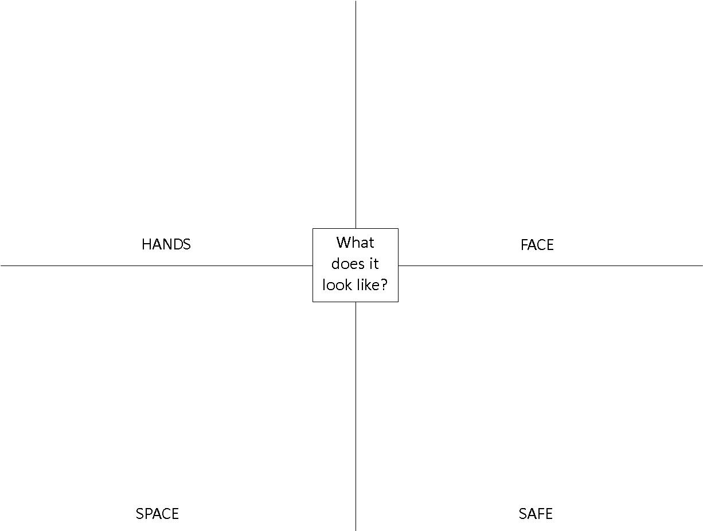

Slide 21
These posters will be posted in classrooms and throughout the building.
Review important steps to “Stop the Spread of Germs” regularly
Click here to print poster
/wp-content/uploads/2020/08/stop-the-spread-of-germs-8.5x11.pdf

Slide 22
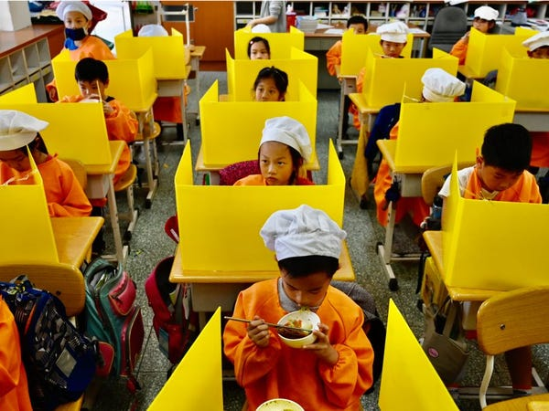
CLASSROOM CONSIDERATIONS
Consider assigning hooks to hang up coats. Spacing in-between if possible.
Consider the CDC guidelines suggests having students all facing the same way, i.e. not sitting too close, sitting next to each other rather than across from each other, etc.
Consider Taiwan uses desk carrels.
Consider talking with students about games they could play at recess that might have social distancing. Kids could invent games that might promote social distancing. (Introduce games such as relays, red light/green light, colored water, obstacle courses based on activities rather than equipment, etc.)
Consider establishing a regular routine of washing hands or hand sanitizer in your classroom. (e.g. before and after recess, entering classroom, etc.) Consider how students can follow a regular routine without standing in a line. (more than one station, markings on the floor to distance, etc.)
Consider KWL charts to gather information and misinformation your students might have.
Taiwan (desk carrels)
Israeli school principal demonstrates to pupils wearing protective masks how to maintain social distancing

Slide 23
https://www.sciencemag.org/news/2020/07/school-openings-across-globe-suggest-ways-keep-coronavirus-bay-despite-outbreaks
Current practices schools around the world as July 7, 2020
When Science looked at reopening strategies from South Africa to Finland to Israel, some encouraging patterns emerged. Together, they suggest a combination of keeping student groups small and requiring masks and some social distancing helps keep schools and communities safe, and that younger children rarely spread the virus to one another or bring it home. But opening safely, experts agree, isn’t just about the adjustments a school makes. It’s also about how much virus is circulating in the community, which affects the likelihood that students and staff will bring COVID-19 into their classrooms.
From the start, some countries bet on strands of research suggesting young children are unlikely to spread the virus: schools in the Netherlands cut class sizes in half but didn’t enforce distancing among students under age 12 when they reopened in April. Other schools adopted a “pod” model as a compromise. Denmark, the first country in Europe to reopen schools, assigned children to small groups that could congregate at recess. It also found creative ways to give those groups as much space and fresh air as possible, even teaching classes in a graveyard. Some classes in Belgium met in churches to keep students spread out. Finland has kept normal class sizes, but prevents classes from mixing with one another.

Slide 24
https://www.sciencemag.org/news/2020/07/school-openings-across-globe-suggest-ways-keep-coronavirus-bay-despite-outbreaks
Current practices schools around the world as July 7, 2020
Should kids wear masks?
Masks likely blunt spread at school, but children—even more than adults—find them uncomfortable to wear for hours and may lack the self-discipline to wear them without touching their faces or freeing their noses. Does discomfort override a potential public health benefit?
“For me, masks are part of the equation” for slowing the spread of COVID-19 in schools, especially when distancing is difficult, says Susan Coffin, an infectious disease physician at the Children’s Hospital of Philadelphia. “Respiratory droplets are a major mode of [virus] transmission,” she says, and wearing a mask places an obstacle in those droplets’ path.
Elsewhere, masks are less central. In some schools in Germany, students wear them in hallways or bathrooms, but can remove them when seated at their (distantly spaced) desks. Austria reopened with this approach, but abandoned masks for students a few weeks later, when officials observed little spread within schools. In Canada, Denmark, Norway, the United Kingdom, and Sweden, mask wearing was optional for both students and staff.

Slide 25
The entire handout is posted on the Prince of Peace website:
Click>> COVID-19 Updates, then>>>Classroom CCOVID-19 Updates, then>>> Hands Face Space Safe
Parent and Family Resources on POP website:
Click>> COVID-19 Updates, then>>> Parent and Families COVID-19 Resources
Other Information On POP Website
Information about our Staff, School, Mission
Our Facebook, Twitter, Instagram, YouTube
Dress Code, Parent\Student Handbook
Parent Association News
Weekly Newsletters, 2020-2021 Calendar, Lunch Information
Questions\Concerns about accessing POP website contents: Contact me, Cathy Cool at ccool@popcov.com

